Slide 1
Computer Architecture

Slide 2
Objectives
Computer
Input and Output Devices
Motherboard and CPU
Port
Machine cycle
Memory vs. Storage
Ergonomics
Types of Computers

Slide 3
Computer

Slide 4
Computer
Computers are Data Processing Devices,
Programmable, electronic device that accepts data, performs operations, presents the results, and can store the data or results
Input—entering data into the computer
Processing—performing operations on the data
Output—presenting the results
Storage—saving data, programs, or output for future use

Slide 5
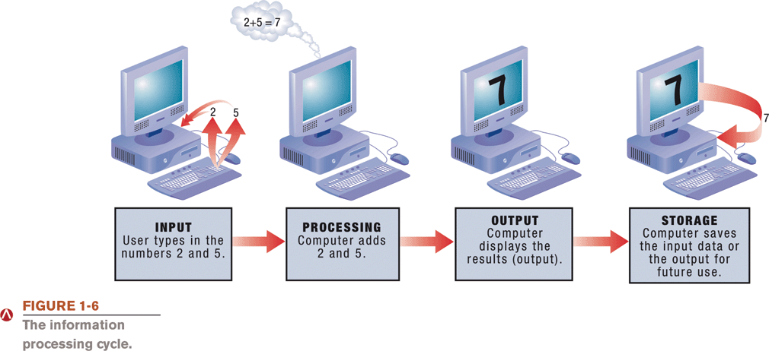

Slide 6
Data Vs Information
Data is a representation of a fact, figure, or idea. Data can be a number, a word, a picture, or even a recording of sound.
Information is data that has been organized or presented in a meaningful fashion.

Slide 7
Bits and Bytes: The Language of Computers
Bit
Binary digit
0 or 1
Byte
Unique combinations of 8 bits of 0s and 1s
Kilobytes, megabytes, gigabytes, and terabytes.
Notes:
Computers need a language they understand. Binary language, consists of two digits: 0 and 1.
Each 0 and 1 is a binary digit, or bit for short. Eight binary digits (or bits) combine to create one byte.
In computers, each letter, number, and special character consists of a unique combination of eight bits.
Files can be quite large, containing thousands or millions of bytes.

Slide 8
Bits and Bytes: The Language of Computers
Name | Abbreviation | Number of Bytes
Byte | B | 1 byte
Kilobyte | KB | 1,024 bytes (2¹⁰) ≈ 10³
Megabyte | MB | 1,048,576 bytes (2²⁰ bytes) ≈ 10⁶
Gigabyte | GB | 1,073,741,824 bytes (2³⁰ bytes) ≈ 10⁹
Terabyte | TB | 1,099,511,627,776 bytes (2⁴⁰ bytes) ≈ 10¹²

Slide 9
The Language of Computers
Computer uses combination of hardware and software to process data into information
Hardware is any part of the computer you can physically touch
Software is set of computer programs
Application software
System software
Operating system (OS)

Slide 10
Input and Output Devices

Slide 11
Input Devices
Enter data and instructions by:
Keyboard
Mouse
Microphone
Scanner
Bar code reader

Slide 12
Output Devices
Send data out of the computer in the form of:
Text - Pictures
Sounds - Video
Examples
Monitor
Printer
Speaker
Plotter

Slide 13
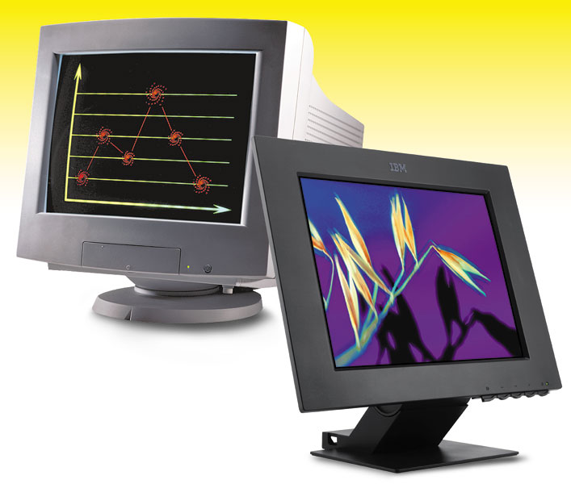
Monitor
A monitor is a peripheral device which displays computer output on a screen.
Screen output is referred to as a soft copy.

Slide 14
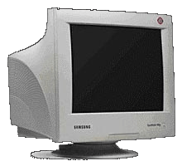
Types of Monitors
CRT
Cathode-ray tube (CRT)
- use picture tube technology; inexpensive, but they take up desk space and use a lot of energy.
Liquid Crystal Display (LCD or flat-panel)– Cells sandwiched between two transparent layers form images; expensive, and they take up less desk space and use less energy than CRT monitors.
Light-emitting diode (LED)
- is more energy-efficient and has better color accuracy and thinner panels than LCD monitors.
LCD

Slide 15
Monitor Specifications
Screen size– The diagonal measurement of the screen surface in inches (15, 17, 19, 21).
Resolution– The sharpness of the images on the screen determined by the number of horizontal and vertical pixels that the screen can display (800x600, 1024x768, 1600x1200).
Dot pitch– The distance between each pixel on the screen measured in millimeters (.22mm, .25mm, .28mm).

Slide 16
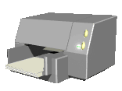
Printers
A printer is a peripheral device that produces a physical copy or hard copy of the computer’s output.
Two basic types:
Impact printer
Nonimpact printer

Slide 17
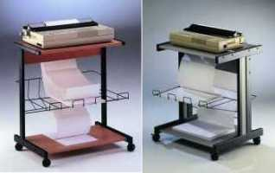
Impact Printer
Impact printer
Dot-matrix
An impact printer is a printer that has a print head that contacts the paper to produce a character.
It uses ink ribbon.
It is noisy, produces Near-letter quality printouts, and is not commonly used today.
Dot-matrix– Pins are used to make characters.

Slide 18
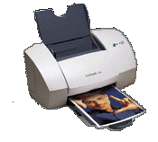
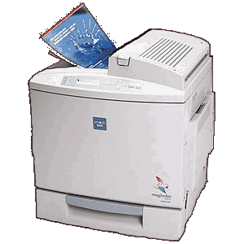
Nonimpact Printer
Inkjet
Laser
Two types of nonimpact printers:
Inkjet printer– are affordable and produce high-quality color printouts quickly and quietly. They spray tiny drops of ink onto paper.
Laser printer use laser beams and static electricity to deliver toner onto the correct areas of the page. Heat fuses the toner to the page.

Slide 19
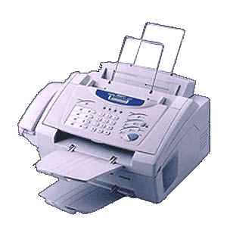
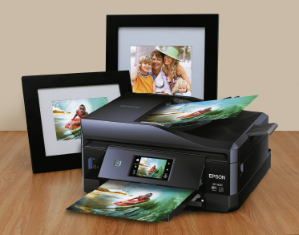
Multifunction Printer
A multifunction printer combines the functions of a nonimpact printer, scanner, fax machine, and copier in one unit.

Slide 20
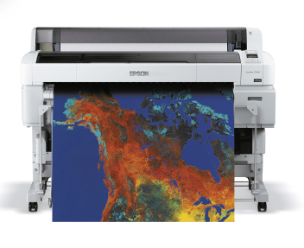
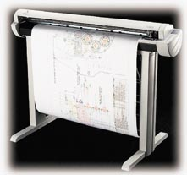
Plotter
A plotter is a printer that uses a pen that moves over a large revolving sheet of paper.
It is used in engineering and map making.

Slide 21
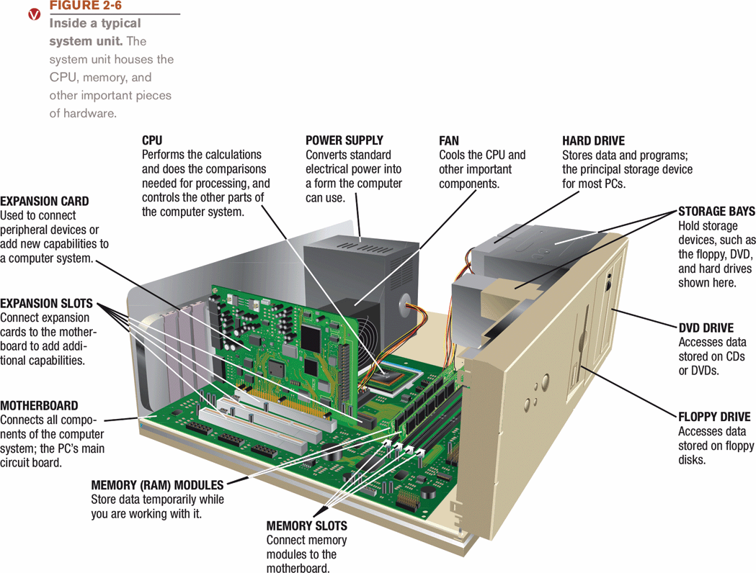
المكونات الداخلية للحاسب

Slide 22
Motherboard
and
CPU

Slide 23
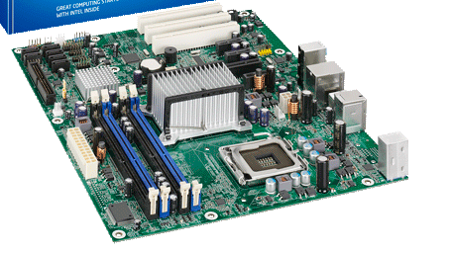

Slide 24
Motherboard
It holds and allows communication between many of the electronic components of a system, such as the central processing unit (CPU) and memory, and provides connectors for other peripherals.
It is on the size of A4 paper, its color is green or gold. On which we can distinguish the following components:

Slide 25
Motherboard
-RAM
-Expansion Slots
-Expansion Cards
-Processor, on which a fan or a heat sink is mounted.
-Battery
-Power supply to convert the 200v ac to 3.3 v dc.
-Clock, which generates series of pulses per second
-Chip Sets
-ROM
-Connectors

Slide 26
Central Processing Unit
CPU or processor
“Brains” of the computer
Controls all functions of the computer’s components
Processes all commands and instructions
Billions of tasks per second

Slide 27
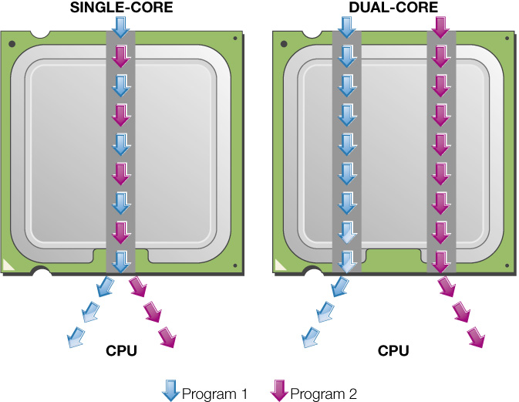
Central Processing Unit
CPU Performance Measures
Processor speed measured in hertz (Hz)
Megahertz (MHz) or gigahertz (GHz)
Number of cores
Single
Dual
Quad
Ten

Slide 28
Port

Slide 29
Port
A port is a place through which a peripheral device attaches to computer so that data can be exchanged between it and the operating system.
Many ports are located on the back of the computer
Some commonly used ports are placed on the front and sides for easier access

Slide 31
Machine cycle

Slide 32
Four steps performed for each instruction
Machine cycle: the amount of time needed to execute an instruction
Personal computers execute in less than one millionth of a second
Supercomputers execute in less than one trillionth of a second
Each CPU has its own instruction set

Slide 34
Memory vs. Storage

Slide 35
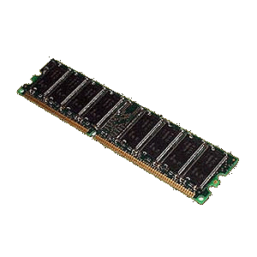
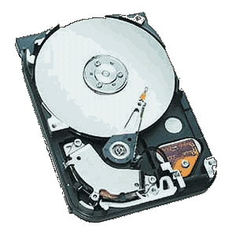
Memory vs. Storage
Hard Drive
RAM Memory
Storage, also known as mass media or auxiliary storage, refers to the various media on which a computer system can store data.
Storage devices hold programs and data in units called files.
Files are stored in directories or folders.
Memory is a temporary workplace where the computer transfers the contents of a file while it is being used.

Slide 37
RAM Vs ROM
Random access memory stores the programs and data the computer is currently using. RAM is much faster than other forms of storage.
RAM is erased when you turn off the computer, so it is volatile storage.
To save data more permanently, save it to the hard drive or another permanent storage device.
Read-only memory holds the instructions needed for startup. ROM is a nonvolatile storage, which means the data isn’t erased when the power is turned off.

Slide 38
Why is storage necessary?
Storage:
Retains data when the computer is turned off.
Is cheaper than memory.
Plays an important role during startup.
Plays an input role when starting applications.
Is needed for output.
Devices can hold a large amount of data.

Slide 39
Storage Devices
Storage devices are:
Hardware that is capable of retaining data when the electricity is turned off.
Able to read (retrieve) data from a storage medium (disk/tape).
Able to write (record) data to a storage medium.

Slide 40
Types of Storage Technologies
Sequential– Hardware that reads and writes data in a serial (one after the other) fashion.
Random-Access– Hardware that reads and writes data without going through a sequence of locations.
Magnetic– Hardware that uses disks or tapes that are coated with magnetic material.
Optical– Hardware that uses laser beams to read data from plastic disks.
Solid State– Devices that use nonvolatile memory chips to read and write data.

Slide 41
The Storage Hierarchy
Storage hierarchy consists of three levels. They are:
Online storage– Also called primary storage, it is made up of the storage devices that are actively available to the computer system. User action is not required.
Near-online storage– Also called secondary storage, it is not readily available to the computer system. The user performs an action, such as inserting a disk, to make it available.
Offline storage– Also called tertiary storage or archival storage, it is not readily available to the computer system. Devices such as tape backup units store data for archival purposes.

Slide 42
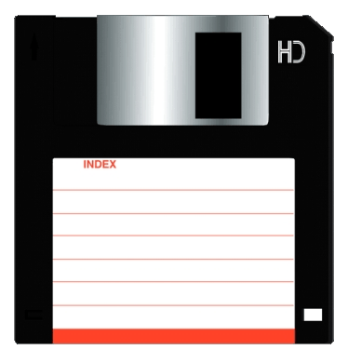
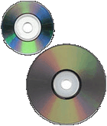
Capacity and Speed of Storage Devices
Floppy Disk
Hard Drive
CD ROM / DVD
Capacity– 720 KB to 1.44 MB
Access Time– 100ms
Capacity– Up to 1 TB
Access Time– 6 to 12ms
Capacity– CD-ROM 650 MB; DVD 17 GB
Access Time– 80 to 800ms
A storage device’s performance is measured by:
Capacity– The number of bytes of data that a device can hold.
Access Time– The amount of time, in milliseconds (ms), it takes for the device to begin reading data.

Slide 43
Disks and Disk Drives
A disk or diskette is a portable storage medium.
Disks are circular plastic disks coated with a magnetically sensitive film.
Disks work with a disk drive.
High-density floppy disks
Floppy disks store 1.44 MB of data.
SuperDisk and High FD disks store up to 250 MB of data.

Slide 44
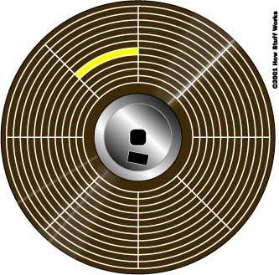
Disk Organization
Track
Sector
Cluster
A disk is formatted–that is, it is divided into tracks and sectors and a file allocation table (FAT) is created.
Track– circular band
Sector– pie shaped section
Cluster– two or more adjacent sectors
FAT– keeps track of specific locations of files

Slide 45
How Hard Disks Work
Platter
Read/Write head
Hard disks are a high-speed, high-capacity storage devices.
The hard disk drive is your computer’s primary device for permanent storage of software and documents.
Hard drives are nonvolatile storage devices.
An internal hard drive resides in the unit and holds all permanently stored programs and data.
Hard disks can be divided into partitions to enable computers to work with more than one operating system.

Slide 46
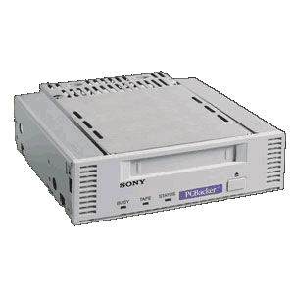
Magnetic Tape
Tape Backup Unit
Magnetic tape backup units store large amounts of data that are not used frequently.
They use a cassette-type reel-to-reel plastic tape.

Slide 47
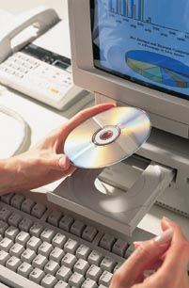
CD-ROM Disks and Drives
CD-ROM stands for Compact Disk-Read Only Memory.
They are capable of storing 650 MB of data.
They are used for storing operating systems, large application programs, and multimedia programs.

Slide 48
CD-R and CD-RW
CD-R
Disks that can be read and written to.
Disks can only be written to “once”.
CD-RW
Disks that can be read and written to.
Disks are erasable.
Disks can be written to many times.

Slide 49
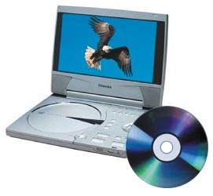
DVD-ROM Disks and Drives
DVD stands for Digital Video Disk.
They use technology similar to CD-ROM.
They are capable of storing up to 17GB of data.
Their data transfer rate is comparable to that of hard disk drives.
DVD-RAM– Has the ability to read/write data.

Slide 50
Types of Computers

Slide 51
Types of Computers
Two basic designs of computers
A. Portable
1. Laptop computers
a portable computer that has a keyboard, monitor, and other devices integrated into a single compact case.
2. Netbooks
a small, lightweight laptop computer that is generally 7 to 10 inches wide and has a longer battery life than a laptop.
3. Tablet
a portable computer integrated into a flat multitouch-sensitive screen. It uses an onscreen virtual keyboard
4. Ultrabooks
a full-featured but lightweight laptop computer

Slide 52
Types of Computers
Two basic designs of computers
B. Stationary
1. Supercomputer
- Performs complex calculations extremely rapidly
- Designed to handle many programs running at the same time.
2. Mainframe
- Supports many users simultaneously
- Designed to execute a few programs as quickly as possible
3. Desktop computers
- A large, expensive computer that Separate case plus peripheral devices.
- Used in businesses that manage large amounts of data.

Slide 53
Types of Computers
Two basic designs of computers
B. Stationary
4. Embedded
- Specially designed computer chip that resides in another device.
- Self-contained computer devices performing dedicated functions.
5. Smartphone
- Does more than let you make and answer phone calls.
- It also has productivity (application software), media player, and camera features, as well as Web connectivity.
- A smartphone has a CPU, memory, and storage just like a laptop computer.

Slide 54
Ergonomics

Slide 55
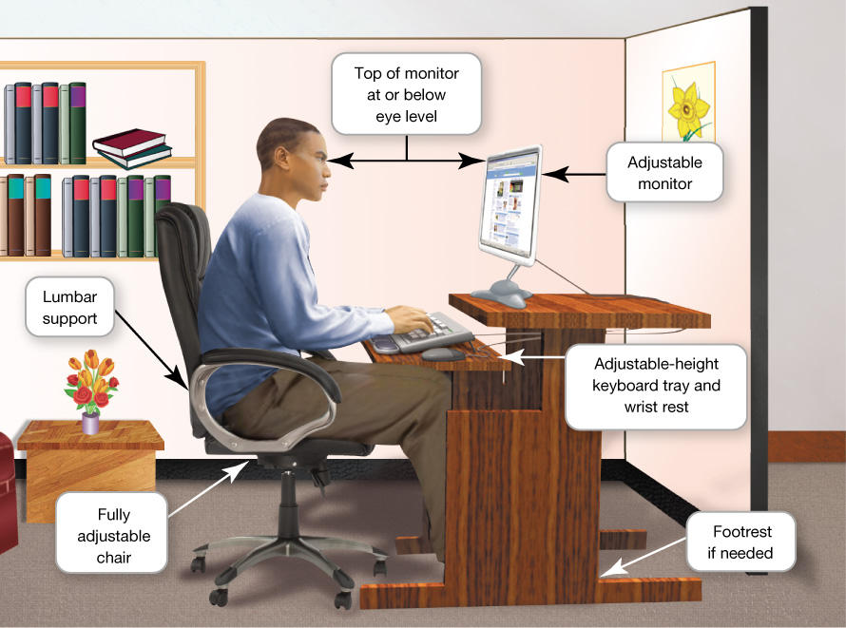
Ergonomics
Ergonomics refers to how you set up your computer and other equipment to minimize your risk of injury or discomfort.
Guidelines:
Position your monitor correctly.
Purchase an adjustable chair.
Assume a proper position while typing.
Take breaks from computer tasks.
Ensure that the lighting is adequate.

